Slide 1



Options Menu

Slide 2
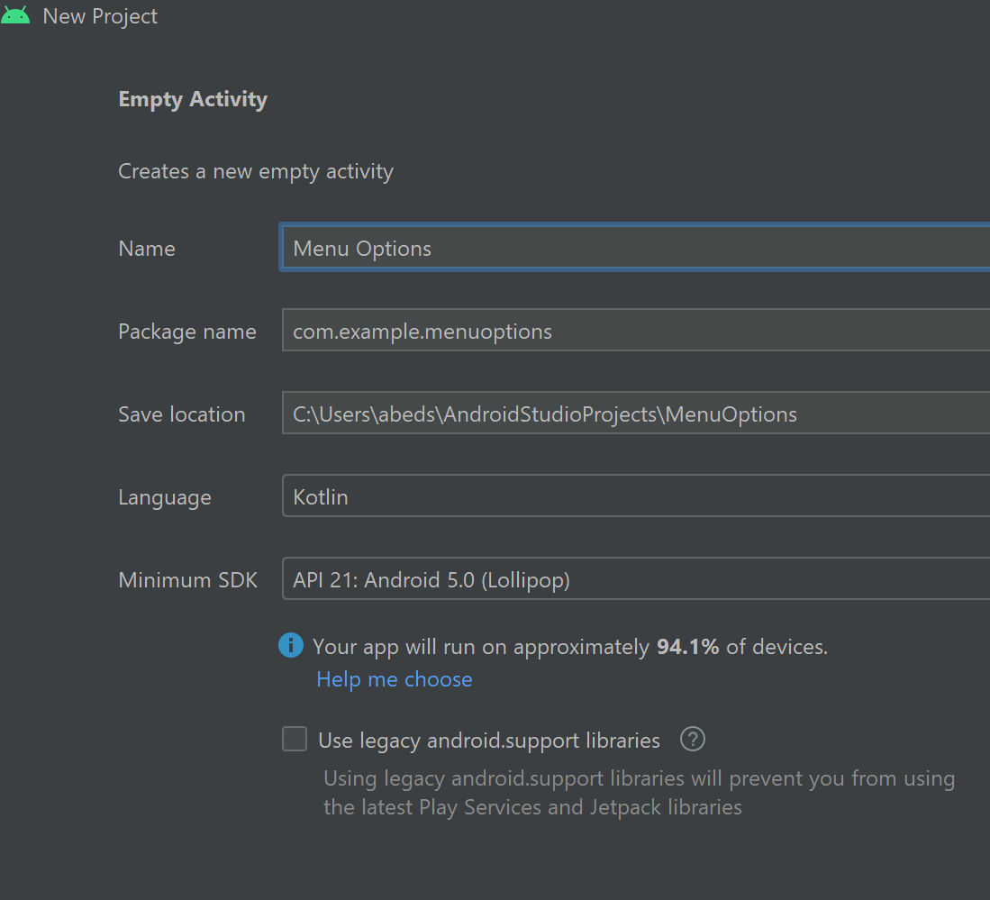
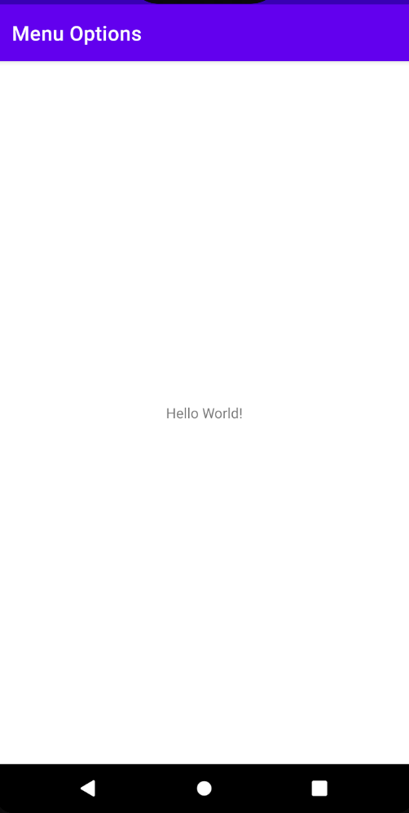
Options Menu
A collection of actionable menu items for an activity
Create an empty app as the following:
Reminder:
to minimize the number of errors and coding time, please run the app after each change!!

Slide 3
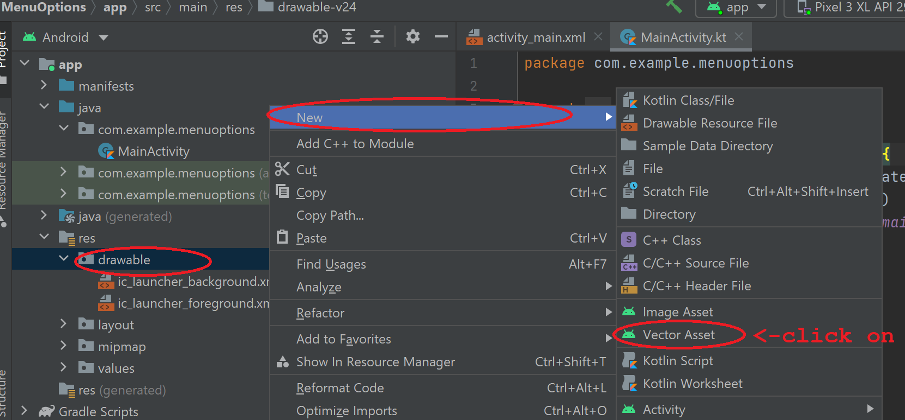
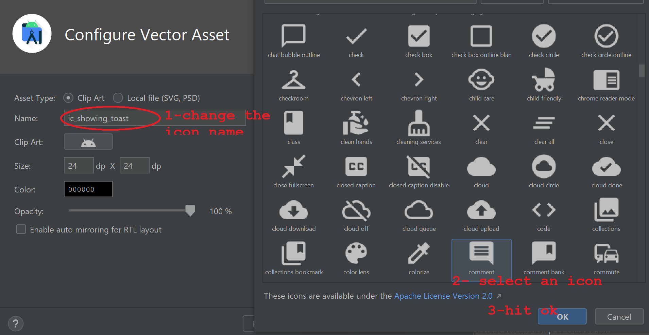
Creating an icon
In this app, ee will be creating action bar item and an option menu.
Finally hit finish!
The steps in this slide to create an icon to be used in the action bar

Slide 4
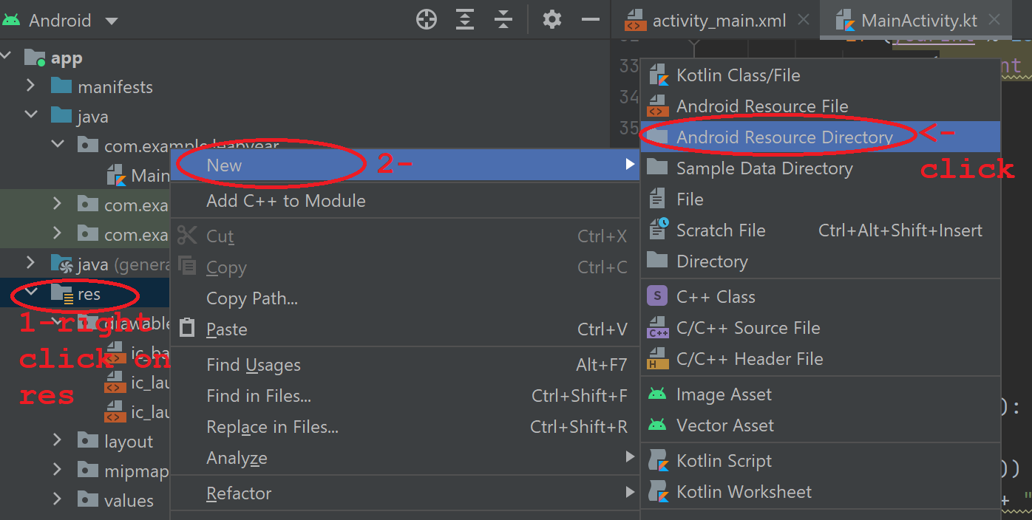
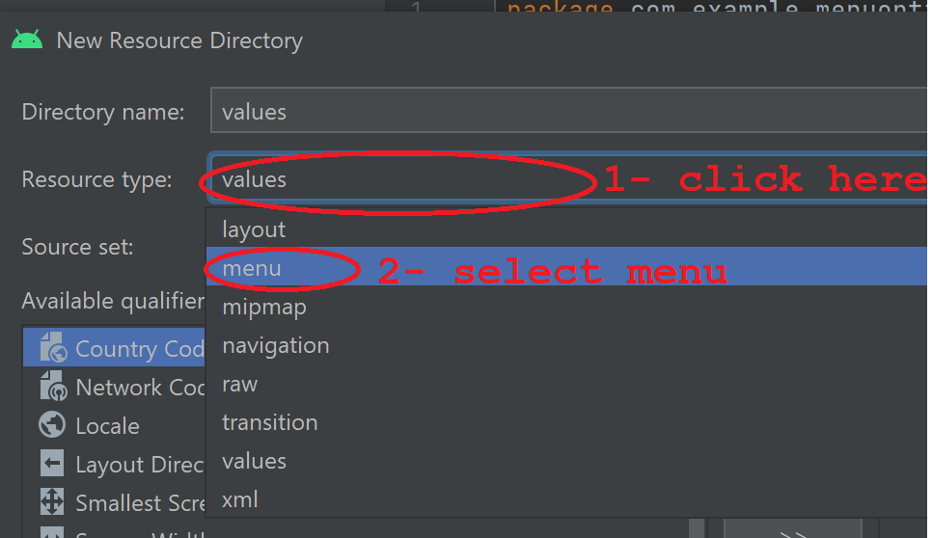
Creating the menu
Create a menu in the res (resources)
Once you are done, ysou should be able to see menu in the res
Hit ok!

Slide 5
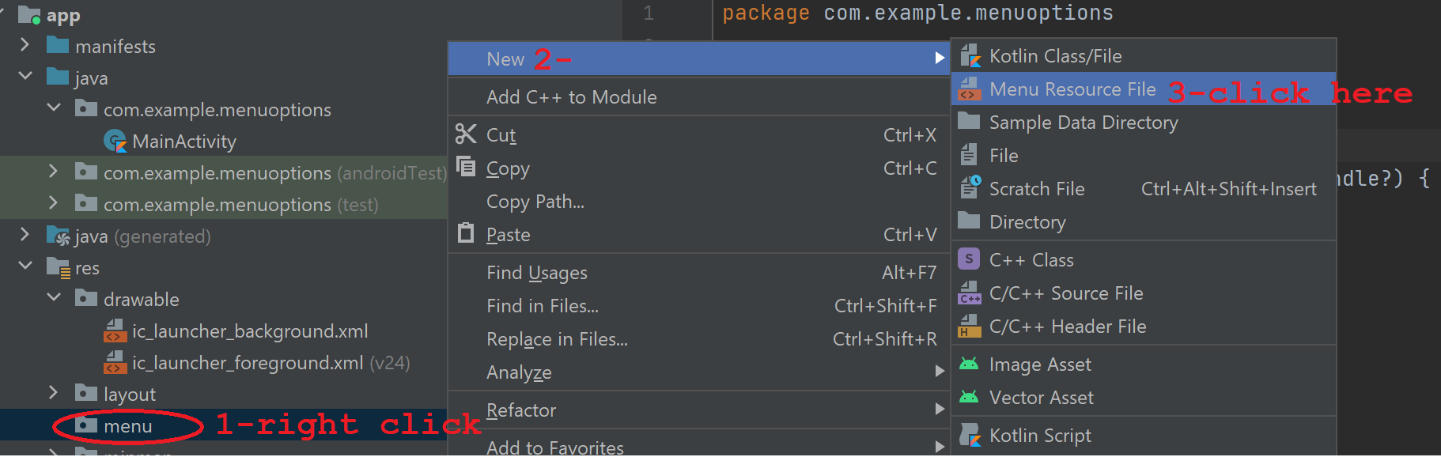
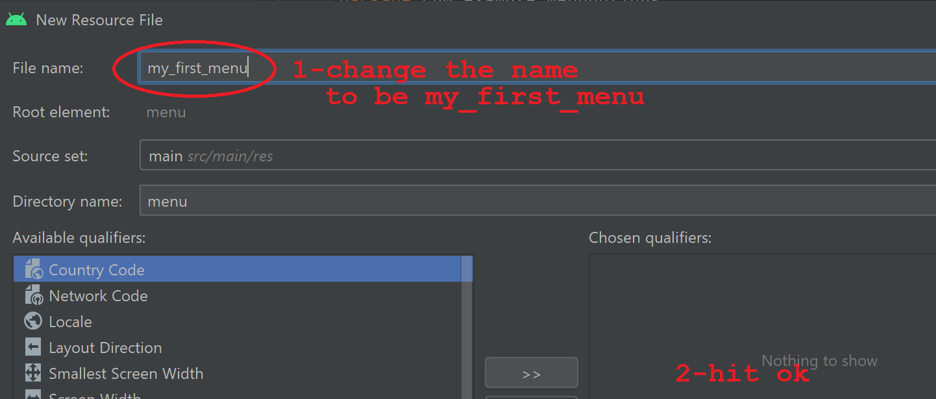
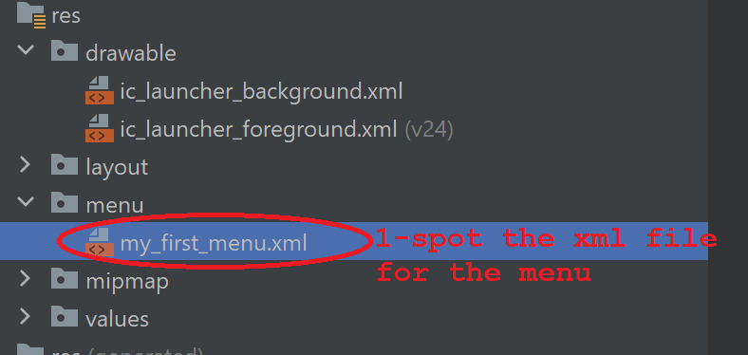
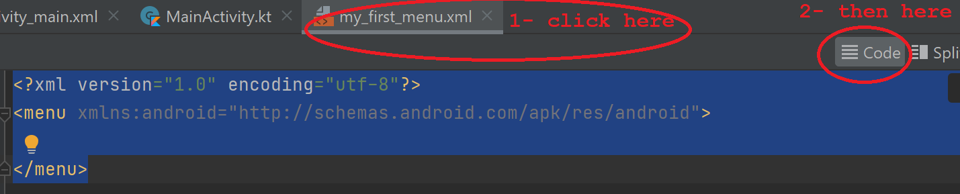
Creating the menu file (XML)

Slide 6
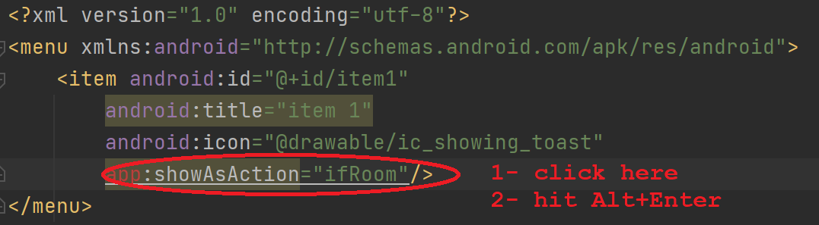
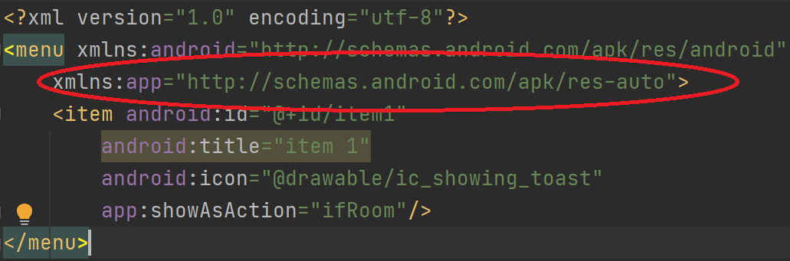
Creating menu items in “my_first_menu.xmls”
Add the following text:
<?xml version="1.0" encoding="utf-8"?>
<menu xmlns:android="http://schemas.android.com/apk/res/android">
<item android:id="@+id/item1"
android:title= " Choice 1"
android:icon="@drawable/ic_showing_toast"
app:showAsAction="ifRoom"/>
</menu>
Set an id for the menu entry
Set a title for the menu entry
Link this menu entry icon with the created one
ifRoom will set the action bar menu on the right top side.
After clicking Alt+Enter, the app naming space will be added to this XML file. Naming space is used to include a specific scope for this menu, which will be the whole app.

Slide 7
Add my_first_menu to the activity
package com.example.menuoptions import androidx.appcompat.app.AppCompatActivity import android.os.Bundle import android.view.Menu import android.view.MenuInflater as MenuInflater1 class MainActivity : AppCompatActivity() { override fun onCreate(savedInstanceState: Bundle?) { super.onCreate(savedInstanceState) setContentView(R.layout.activity_main) } override fun onCreateOptionsMenu(menu: Menu): Boolean { // Inflate the menu to use in the action bar val inflater = menuInflater inflater.inflate(R.menu.my_first_menu, menu) return super.onCreateOptionsMenu(menu) } }
Change MainActivity.kt to have the following:
- We must override onCreateOptionsMenu() function creates option menu.
- inflate() method of MenuInflater class inflates the displayed menu my_first_menu.

Slide 8
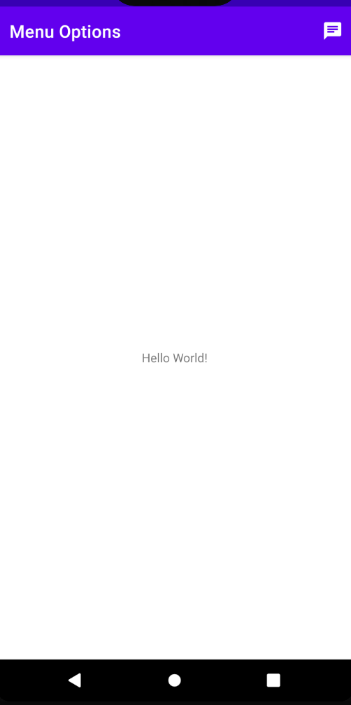
Let’s run it!
Something missing!!

Slide 9
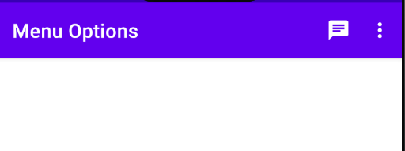
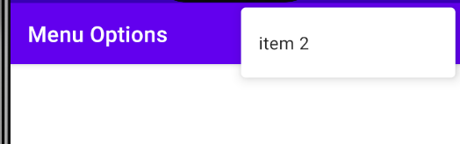
Add more menu items
<?xml version="1.0" encoding="utf-8"?>
<menu xmlns:android="http://schemas.android.com/apk/res/android"
xmlns:app="http://schemas.android.com/apk/res-auto">
<item android:id="@+id/item1"
android:title="item 1"
android:icon="@drawable/ic_showing_toast"
app:showAsAction="ifRoom"/>
<item android:id="@+id/item2"
android:title="item 2"
app:showAsAction="never"/>
</menu>
Add item 2, with “never” showAsaction to be part of the menu (not action bar item).

Slide 10
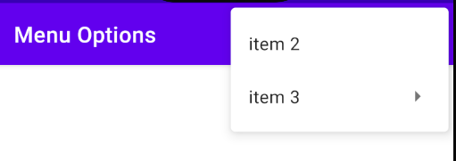
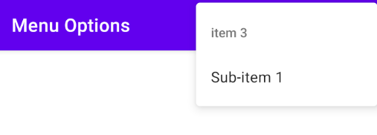
Add sub-menu
<item android:id="@+id/item3"
android:title="item 3"
app:showAsAction="never">
<menu>
<item android:id="@+id/subitem1"
android:title="Sub-item 1"
app:showAsAction="never"/>
</menu>
</item>
</menu>
Add this item at the end before </menu>, this item is different than the ones before:
1- we use <item> instead of /> to close the tag.
2- between <item> </item> we include the sub menu using <menu> </menu> tags.
3- in <menu> </menu>, we create the sub-menu

Slide 11
Action is missing
In MainActivity.kt, We must override onOptionsItemSelected function to act ( create the actions).
override fun onOptionsItemSelected(item: MenuItem): Boolean { when(item.itemId){ R.id.item1 ->Toast.makeText(this, "item 1 selected", Toast.LENGTH_SHORT).show() R.id.item2 -> Toast.makeText(this, "item 2 selected", Toast.LENGTH_SHORT).show() R.id.subitem1 -> Toast.makeText(this, "Sub-item 1 selected", Toast.LENGTH_SHORT).show() } return true; }
We can use item (of type MenuItem) to verify which item was triggered.

Slide 12
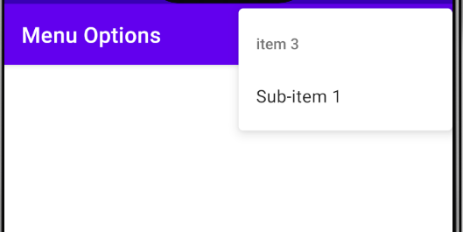
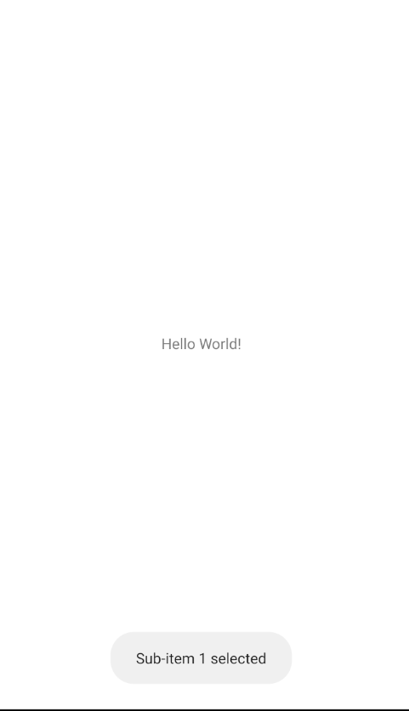
Let’s try it!

Slide 13
References
https://www.javatpoint.com/kotlin-android-options-menu
https://www.youtube.com/watch?v=oh4YOj9VkVE

